Slide 1
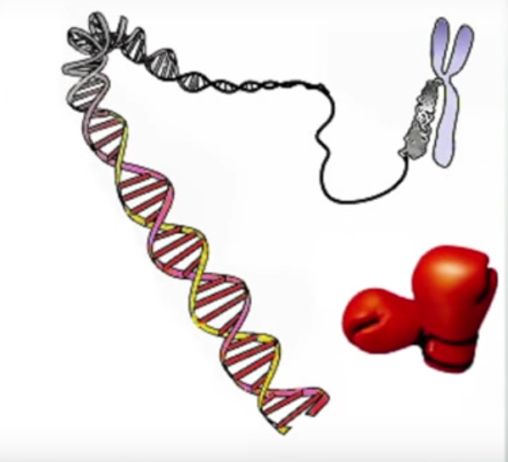
Introduction
Why the knock-out ?
It is useless to have many books if you aren’t able to read.
Main idea : the value of something is revealed when it doesn’t exist anymore

Slide 2
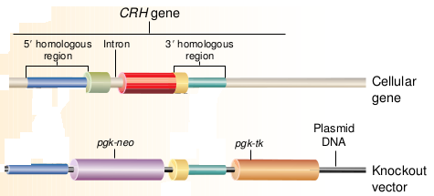
Creation of the targeting vector
The immediate neighbour sequences of the targeted gene are copied in the knockout vector.
The gene that will take the place of the targeted one (pgk-neo here) is : damaged version ; selection marker

Slide 3
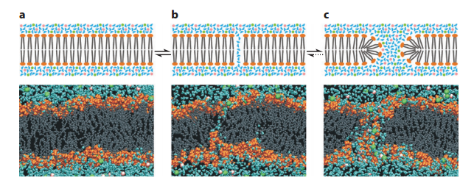
Introduction of this vector
Electroporation : use of the electrical charge of the plasmid (negative) to introduce it into the cell.

Slide 4
Positive negative selection
The selection marker is a gene coding for antibiotic resistance
In the presence of the antibiotic, the wild type cells will die but not the mutated one

